Slide 1

AI DRIVEN PERSONALIZED RECIPE GENERATOR
Based on artificial intelligence

Slide 2
6
DEPARTMENT OF COMPUTER SCIENCE AND ENGINEERING
2023-24
PROJECT ON
“AI DRIVEN PERSONALIZED RECIPE GENERATOR ”
PRESENTED BY
Miss. Neha Subhash Kumbhar
Miss. Namrata Dilip Pawar
Miss. Ankita Dnyandev Sanas
Miss. Vaishnavi Santosh Mahamulkar
UNDER THE GUIDANCE OF:- Prof. Shital Waghmare

Slide 3

Contents-
1. Introduction
2. Literature Review
3. Block Diagram
4. Proposed work
5. Conclusion
6. References

Slide 4
Introduction
The AI-Driven Personalized Recipe Generator is an innovative solution designed to transform meal planning through the power of artificial intelligence. As more people seek to align their meals with personal dietary needs, health goals, and taste preferences, this tool offers a personalized approach by generating recipes uniquely suited to individual users. Unlike traditional recipe databases, which often lack adaptability, this AI-driven generator leverages machine learning to understand user inputs, such as dietary restrictions, preferred ingredients, and even available pantry items.
By analyzing these factors, the system produces custom recipes that not only meet nutritional and culinary requirements but also encourage healthy, diverse, and sustainable eating habits. This solution not only supports individuals in making healthier food choices but also contributes to reducing food waste by utilizing available ingredients effectively.

Slide 5


This is the register page and login page where the user will first do the registration and then login

Slide 6
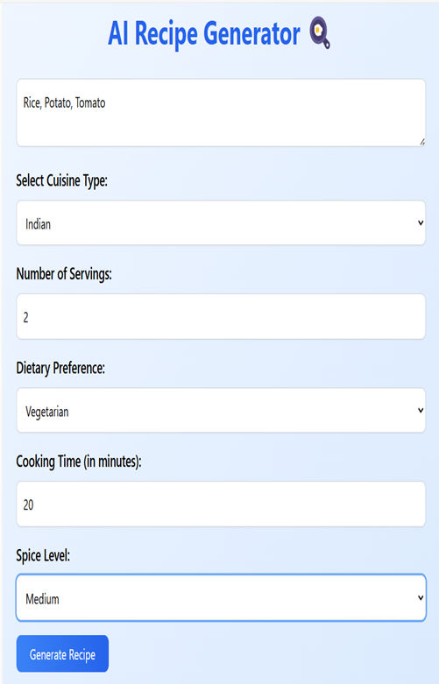
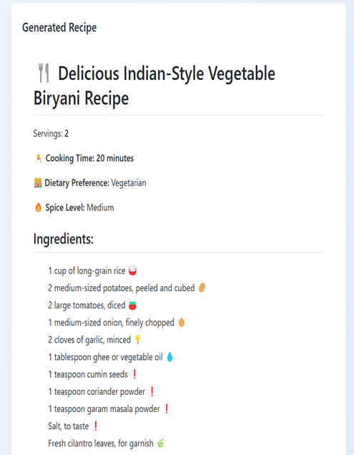
After log in , the user will insert the ingredients and according to user preferences such as dietary preferences, cooking time, cuisine type , spice level the recipe will be generated .
It will give the detailed recipe according to the available ingredients.

Slide 7
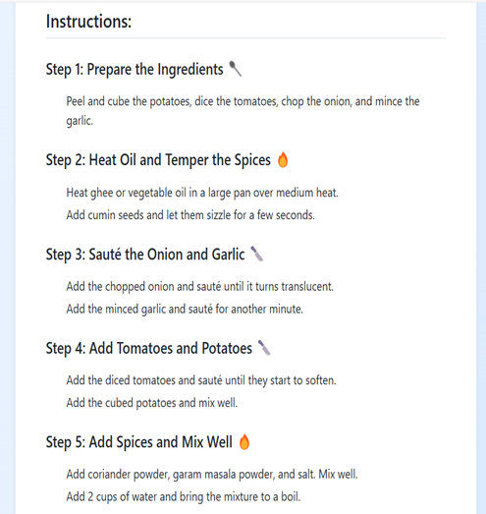
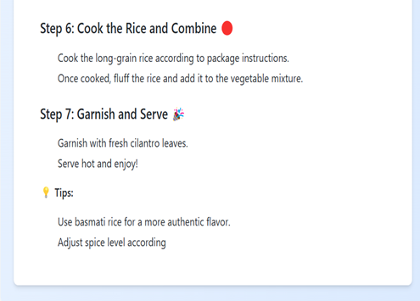
Recipe generator will give step by step instructions of how the recipe must be made.
It will also give some tips for better cooking .

Slide 8
Literature Review-
1. The development of AI-based recipe generators and cook assistants holds significant promise for revolutionizing the way people discover, prepare, and enjoy food. Through advanced algorithms and machine learning techniques, these systems can offer personalized recipe recommendations, assist users in meal planning and grocery shopping, and provide step-bystep guidance during the cooking process. However, while AI-powered culinary assistants offer exciting opportunities, several challenges and considerations must be addressed. These include ensuring the accuracy and reliability of recipe recommendations, accommodating diverse dietary preferences and restrictions, and maintaining user privacy and data security.
2. AI-powered recipe generation structures, ultimately enhancing the culinary adventure for customers worldwide. The advanced recipe generator is based on state-of-the-art AI and ML solutions that offer one an in-depth customer experience. There are many layers of processes from data collection to results generation: the recipe databases, culinary literature, and user data were combined by the advanced AI technique in order to communicate intricate patterns connected to the ingredients usage, the link between chosen ingredients and chosen recipes, and harmonic interactions between ingredients.

Slide 9
3. The project enabled understanding the changes in output affected by the change made in hyper parameters. After successful creation of the model generating seemingly precise model we can move ahead to the next step of adding features to enhance user interactions. In future the model can make use of pre-trained transformers for definite and cohesive text generation thus correcting the model prediction and accuracy. Furthermore to make the project ideal and efficient other filters for searching along with search by ingredients can be added, such as search by image, search by cuisine type, health monitoring of recipes generated. Adding another approach to recipe generation such as recipe generation from title rather than ingredients, can be an innovative direction to recipe generation using AI.
4. The proposed work experimented with different modules and permutations of different methods to provide the most accurate results. An interactive web app was subsequently created for ease of access and interactivity. Further, an exhaustive survey was conducted over a set of expected properties of the recipes generated by the evolutionary model. The feedback received supported the acceptance of newly generated unique Indian cuisine-centric recipes; more than 86% agreed that they might prepare/cook the recipe generated by the model.

Slide 10
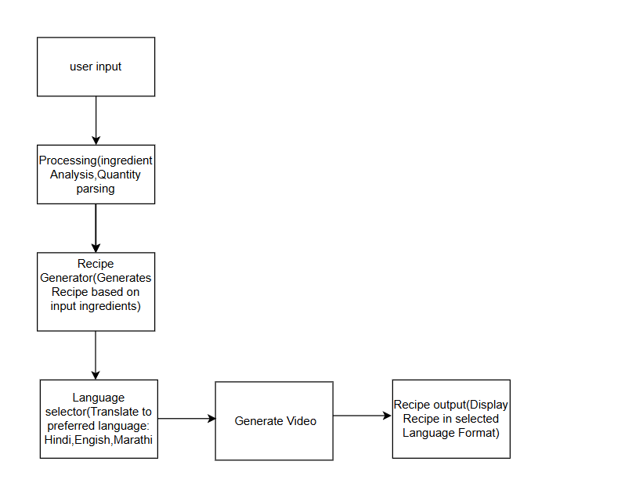
Block Diagram

Slide 11
Proposed Work-
1. Research and Development: Conduct literature reviews and user surveys to understand needs.
2. System Design: Plan architecture and create user-friendly UI/UX designs.
3.Data Collection: Build a diverse recipe database and enable user input for preferences and ingredients.
4. Algorithm Development: Implement machine learning for personalized recommendations and nutritional analysis.
5. Prototyping and Testing: Develop a prototype and conduct user testing for feedback.
6.Iterative Improvement: Use feedback to enhance the system and implement continuous learning.

Slide 12
Conclusion
In conclusion, the development of AI-based recipe generators holds significant promise for revolutionizing the way people discover, prepare and enjoy food. Through advanced algorithms and machine learning techniques, these systems can offer personalized recipe recommendations, assist users in meal planning and grocery shopping and provide step-by-step guidance during the cooking process.
However, while AI-powered recipe generator offer exciting opportunities, several challenges and considerations must be addressed. These include ensuring the accuracy and reliability of recipe recommendations, accommodating diverse dietary preferences and restrictions and maintaining user privacy and data security.
Moreover, the success of AI-based recipe generators ultimately depends on their ability to enhance the overall cooking experience for users. This involves not only providing practical assistance but also fostering creativity, exploration and enjoyment in the kitchen.

Slide 13
References
1. Devarasetty Tejaswini, V Sankar Reddy(2024) Ai Based Recipe Generator And Cook Assistant published in journal International Journal of creative research Thoughts(IJCRT).
2. 1Akshara Pareek, 2Aastha Kanwar Gahlot, 3Neha Khatri, 4Mohnish Sachdeva(2024) Enhancing Recipe Generation Using AI and ML published in International Journal of Novel Research and Development(IJNRD)
3. Disha Moolya1 , Sakshi Pansare2 , Anushree Kshirsagar3 , Prof. Sonali Bodekar-Kale4(2022) Recipe Generator using Deep Learning published in Journal International Journal for Research in Applied Science & Engineering Technology (IJRASET).
4. Smriti Chaudhary, Binita Soni, Aditya Sindhavad, Archi Mamaniya, Ashwini Dalvi, Irfan Siddavatam(2022) ChefAI.IN: Generating Indian Recipes with AI Algorithm published in Journal International Conference on Trends in Quantum Computing and Emerging Business Technologies (TQCEBT) CHRIST (Deemed to be University).
5. Tejas D and Varun C M(2024) A Literature Survey on Recipe Generation From Food Images using AI/ML International Journal of Advanced Research in Science, Communication and Technology (IJARSCT) .

